Slide 1

Bank Marketing Project
Data Mining and Knowledge Discovery
Date Presented:
13th May 2024
Notes:
Welcome everyone, today our Group will present our project on machine learning methods applied to bank marketing. We aim to predict customer responses to bank marketing campaigns using various modelling techniques and compare the results to streamline marketing operations.

Slide 2
Content
Introduction Problem Definition Objective Challenge Dataset Description
Methods Data Pre-Processing Performance Measures Model Training and Optimizing
Results Model Comparison Performance Measures Model Training and Optimizing
Discussion Knowledge Discovery Objective Challenge Dataset Description

Slide 3
Introduction
Background | Problem Definition | Objective | Challenge
Analyzing customer information is important for bank. Personalized marketing Resource optimization Increased profitability Risk management | The marketing campaigns aimed to access if the bank term deposit would be subscribed | Learn from the existing data Build a good model to predict whether a new client will make a term deposit Identify as many “YES” clients as possible | Data quality and completeness Variable selection Dynamic changes in customer behavior
Notes:
We are focusing on a dataset from a Portuguese banking institution. The primary question is whether a customer will subscribe to a bank term deposit, based on data from direct marketing campaigns.
Our objective is to learn from existing data to build a robust model that predicts whether a new client will subscribe to a term deposit, and to identify as many positive responses as possible.
We face challenges including data quality and completeness, variable selection, and dynamic changes in customer behaviour, which all affect our predictive model’s accuracy

Slide 4
Dataset Description
DATA SOURCE
A Portuguese banking institution
DATASET OVERVIEW
41,188 observations and 21 attributes
COLLECTION METHOD
Cellular and telephone
COLLECTION DURANTION
May 2008 - November 2010

Slide 5

Dataset Description
Introduction
Dataset Overview
Purpose
The dataset is sourced from a Portuguese banking institution and was created to predict the success of bank telemarketing efforts.
Comprising 41,188 observations and 21 attributes, including client data, campaign details, and social-economic indicators.
Aimed at building predictive models to identify the likelihood of a client subscribing to a term deposit, aiding in resource optimization for future marketing campaigns.
Notes:
Our dataset consists of 41,188 observations and 21 attributes collected from May 2008 to November 2010 through methods such as cellular and telephone contact.

Slide 6
Dataset Description
No | Attribute Name | Data Type | Missing Value Percentage %
1 | age | integer | 0
2 | job | categorical | 0.8
3 | marital | categorical | 0.2
4 | education | categorical | 4.2
5 | default | categorical(binary) | 20.9
6 | housing | categorical(binary) | 2.4
7 | loan | categorical(binary) | 2.4
8 | contact | categorical | 0
9 | month | date | 0
10 | day_of_week | date | 0
No | Attribute Name | Data Type | Missing Value Percentage %
11 | duration | integer | 0
12 | campaign | integer | 0
13 | pdays | integer | 0
14 | previous | integer | 0
15 | poutcome | categorical | 0
16 | emp.var.rate | numeric | 0
17 | cons.price.idx | numeric | 0
18 | cons.conf.idx | numeric | 0
19 | euribor3m | numeric | 0
20 | nr.employed | numeric | 0
21 | y(output) | categorical(binary) | 0

Slide 7
Dataset Description
-Handling Missing Values
01 Categorical Variables
02 Special Case: pdays
03 Data Standardization
Missing/unclear responses (e.g., 'unknown' in education) set as NA
'999', indicating no prior contact, converted to NA for clarity
Ensures uniform marking of missing data across variables for reliable analysis
Notes:
We addressed missing values in our dataset by setting unclear responses as 'NA'. A special case was 'pdays', where '999', indicating no prior contact, was converted to 'NA' for clarity.

Slide 8
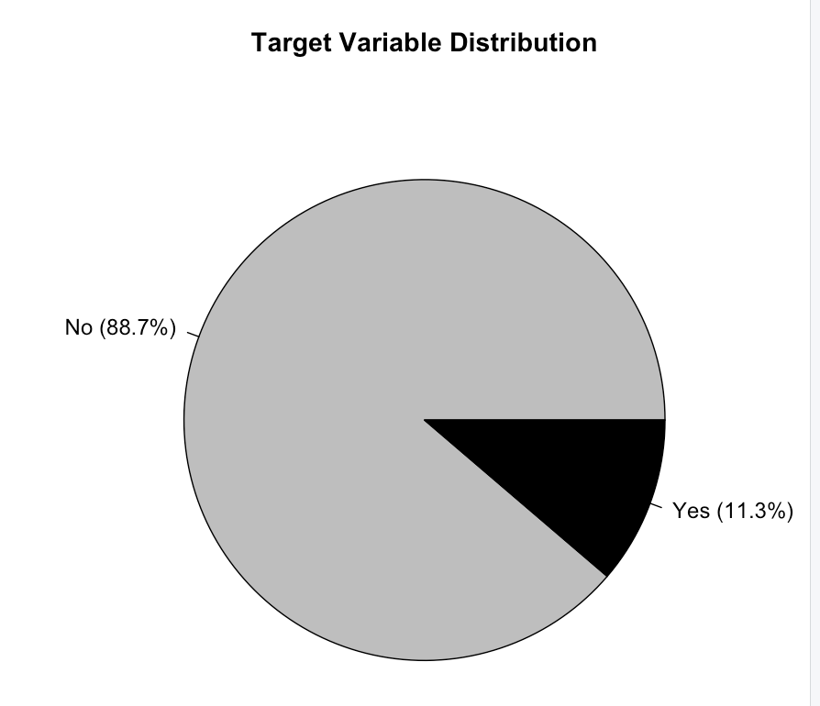
Dataset Description
- Target Variable
88.7% no
11.3% yes
Imbalanced dataset caused problems for prediction because guessing no every time would lead to over 80% accuracy.
Notes:
In our dataset, the distribution of the target variable is highly imbalanced with 88.7% of the responses being 'no' and only 11.3% 'yes.' This imbalance poses a challenge for predictive modelling, as a simple strategy of always predicting 'no' would yield over 80% accuracy, skewing the model's performance metrics and reducing its practical effectiveness in identifying potential 'yes' responses.

Slide 9
Variable Description
01
02
03
Client Information
Contact Details
Campaign Data
Includes age, job, marital status, education, default status, housing, and loan status.
Type of communication (contact), last contact month (month), and day of the week.
Duration not included in the predictive model as it highly influences the outcome (known post-contact).
Number of contacts during the current campaign (campaign)
Days since last contact from a previous campaign (pdays)
Number of contacts before this campaign (previous)
Outcome of the previous marketing campaign (poutcome).
Notes:
The variables include client demographics, contact details, and campaign data, such as the number of contacts and the outcome of previous marketing campaigns.

Slide 10
Dataset Description
-Potential Biases
01 Selection Bias
02 Response Bias
03 Measurement Bias
Clients may not represent the general banking population
Economic conditions during the collection period could affect generalizability
Potential negative reactions to telemarketing could skew results.
Multiple contacts might influence client responses differently.
Possible errors in recording responses or demographic information.

Slide 11
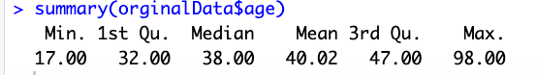



Attributes Analysis
- age
Range
Ages span from 17 to 98 years, with a concentration between 32 and 47 based on the interquartile range
Skew
Data slightly skews towards older individuals, evident from the higher mean age compared to the median
Data Integrity and Outliers
No invalid entries detected, indicating clean data without outliers
Interpretation of Age Distribution
Distribution is relatively uniform, with a mild skew towards older clients. Higher age values in the third quartile and maximum indicate a notable presence of seniors in the demographic
Notes:
Age distribution in our data is relatively uniform but skews towards older clients, indicating a notable presence of seniors, which could impact the model’s predictions.

Slide 12
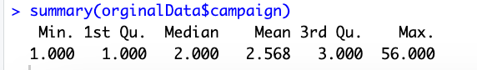
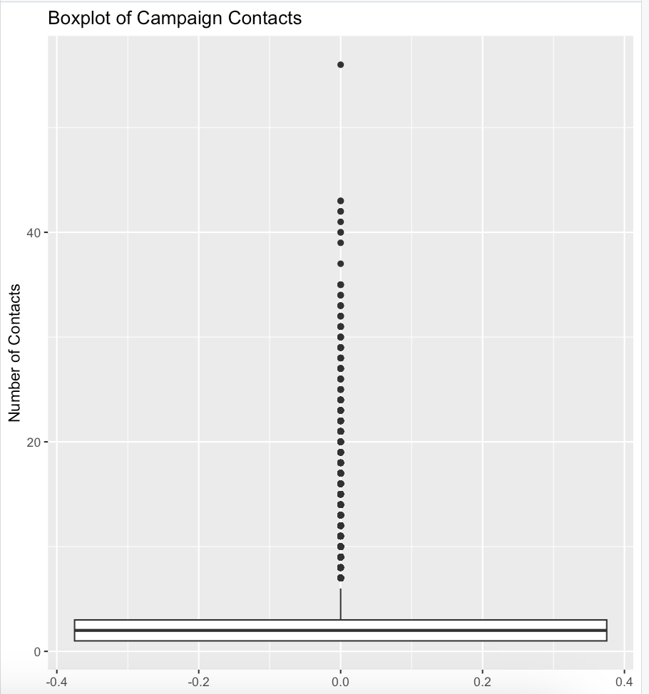
Attributes Analysis
- campaign contact
Most interactions ranging from 1 to 3 calls
Maximum deviation: 56 contacts
Half of the campaign contacts were tightly grouped
Clients with over 30 were removed as outliers
Notes:
Analysis of the campaign contact attribute shows most interactions ranged from 1 to 3 calls, with those over 30 contacts considered outliers and a notable maximum of 56 calls (what a beautiful world we live in that someone got contacted by a Portuguese bank 56 times).

Slide 13
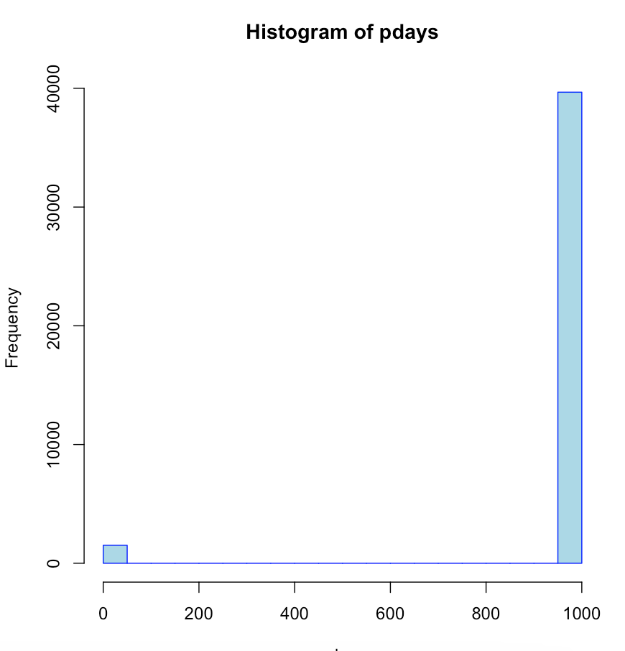
Attributes Analysis
- pdays
Represents days since the last contact from a previous campaign.
Client categories
Never contacted previously: 'pdays = 999’.
contacted within the last month: indicated by 'pdays < 30'.
No invalid entries were found. The high frequency of '999' illustrates a large proportion of new or uncontacted clients;
Values greater than 30 are considered noise points.
Notes:
For 'pdays', a high frequency of '999' indicates many clients were never contacted before, which impacts the interpretation of data and subsequent predictions.

Slide 14
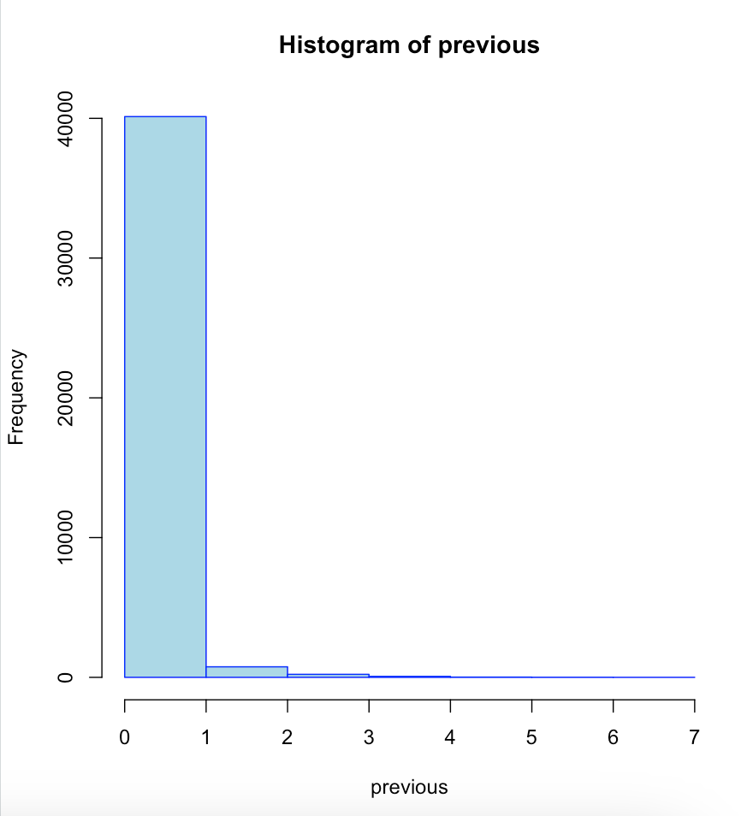
Attributes analysis
- previous
Represents prior contact before the current campaign.
The histogram peaks at zero, suggesting that most clients are first-time contacts. There are no signs of erroneous data entries or outliers; the frequency of 'previous' contacts appears legitimate.
Frequency of Prior Contacts
Majority: Most clients had no prior contact
Minority: A smaller number of clients were contacted 1 to 4 times
Notes:
Most clients were contacted for the first time in the current campaign, as shown by a peak at zero in the histogram for 'previous' contacts.

Slide 15
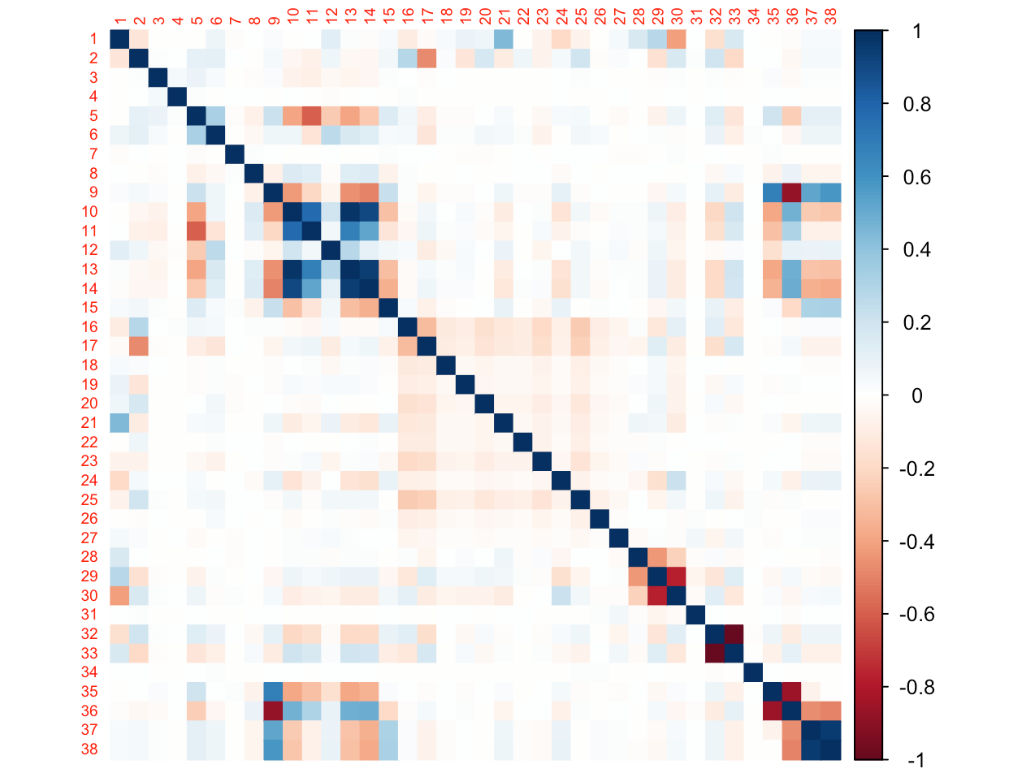
Attributes analysis
- correlation
Color Shades Indicating Correlation Strength: In this heatmap, No. 15 represents the target value. It exhibits a strong linear relationship with the following variables:

Slide 16
Attributes analysis
- Correlation
Variable Number | Variable Name
9 | Previous
10 | emp.var.rate
11 | cons.price.idx
13 | euribor3m
14 | nr.employed
36 | poutcomenonexistent
37 | poutcomesuccess
38 | previous_contacted
Notes:
We conducted a correlation analysis to understand the relationships among variables, particularly how they relate to our target variable, leading to insights for feature selection.
More red indicates a negative, blue is positive and white is low correlation.

Slide 17
DATASET SPLIT
Traing Set
Data Split Strategy
Training set: used to develop the models.
Testing set: reserved to evaluate the final model performance.
Purpose
Ensures unbiased model evaluation and robustness against overfitting.
Original Set
Test Set

Slide 18

Group 20
Content
Introduction Problem Definition Objective Challenge Dataset Description
Methods Data Pre-Processing Performance Measures Model Training and Optimizing
Results Model Comparison Performance Measures Model Training and Optimizing
Discussion Knowledge Discovery Objective Challenge Dataset Description

Slide 19
Data Pre-Processing
Encoding Variables
Categorical variables & ordinal variables
Dealing with Missing Entries
Implementing strategies to handle gaps in the dataset, ensuring robustness in the analysis
Engineering New Variables
Creating additional features that can enhance model performance by capturing more complex patterns
Normalizing Data
Adjusting the scale of the data to improve algorithm performance and ensure fair contribution from all features
Notes:
We prepared our data through encoding methods, handling missing entries, and normalizing the data to ensure quality input for our models.

Slide 20
Encoding Categorical Variables Using One-Hot Encoding
Method
Transforms categorical variables into binary columns.
Implementation in R
We utilized a model.matrix(~ variable—1, data) for variables like job, marital, and outcome.
Example
Job types encoded into columns such as job_admin., job_blue-collar, marked as 1 for presence and 0 for absence.
Advantage
Preserves categorical distinctions without implying ordinality, crucial for linear modeling.
Variable Number | One-Hot
1 | 00001
2 | 00010
3 | 00100
4 | 01000
5 | 10000
Notes:
Categorical variables like job and marital status were encoded using one-hot encoding to preserve categorical distinctions without implying ordinality.

Slide 21
Encoding Ordinal Variables
Education Level | Encoded Value
illiterate | 0
basic.4y | 1
basic.6y | 2
basic.9y | 3
high.school | 4
professional.course | 5
university.degree | 6
unknown | NA
Overview
Targets variables with a natural order, like education.
Encoding Strategy
Assigns integers to maintain order, from "illiterate" (0) to "university.degree" (6).
Purpose
Enhances model's recognition of order, boosting predictive accuracy and result interpretability.
Notes:
We encoded ordinal variables such as education level from 'illiterate' to 'university degree' to maintain their natural order in the data.

Slide 22
Dealing with Missing Entries for Default
Purpose
Improves model's understanding of data patterns by addressing missing values.
New Variable: Default Status Indicator
Created to flag missing data in the 'default' variable. Entries marked as 'unknown' are transformed into a binary indicator (1 for 'unknown', 0 otherwise).
Impact
Allows the model to distinctly account for unknown default statuses, potentially aiding in more accurate risk assessments and predictions.
Default Status | default_no | default_yes | default_unknown
no | 1 | 0 | 0
yes | 0 | 1 | 0
unknown | 0 | 0 | 1
Notes:
To improve data pattern recognition, we addressed missing values in the 'default' variable by introducing the Default Status Indicator. This binary indicator flags 'unknown' entries as '1' and all others as '0'. This distinction helps our model make more accurate risk assessments and predictions by clearly identifying missing data.

Slide 23
Purpose
Enhances pattern recognition within the model.
New Variable previously_contacted:
Created from pdays: 1 if previously contacted (pdays != 999), 0 otherwise.
Impact
Improves model's understanding of prior contact influence on campaign outcomes.
Engineering New Variables
Notes:
We engineered new variables to improve the model's accuracy, such as 'previously_contacted,' which tracks prior client interactions.

Slide 24
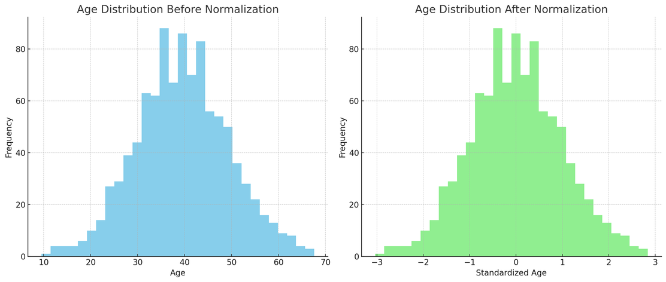
Normalizing Data
Effects on Logistic Regression & SVM
Ensures uniform influence across all features, preventing scale bias.
Enhances interpretability of model coefficients, providing clearer insights for better decision-making.
Normalization Benefits
Stabilizes feature variance, aligning with the Central Limit Theorem to enhance algorithm convergence and model stability.
Notes:
Normalizing the data ensures that all features contribute equally to our model. This process prevents any single attribute from disproportionately influencing the outcomes, improving the performance and convergence of our algorithms. Additionally, normalization enhances the interpretability of model coefficients, making the insights from our analysis clearer and more useful for strategic decision-making.

Slide 25
Performance Measures
Notes:
Thanks, Lachlan. Now, we'll discuss four key performance measures for evaluating our models.

Slide 26
Performance Measures
Accuracy
(Overall Correctness)
imbalance dataset
Specificity🌟
(True Negative Rate for "Yes")
identify “YES” customer
Balanced Accuracy🌟
(Average of Sensitivity and Specificity)
overall performance
AUC
(Classification Ability)
random guess
Notes:
1. Accuracy measures the overall correctness of predictions. However, with an imbalanced dataset like ours, it can be misleading, so it's not our primary metric.
2. Specificity identifies how well the model detects "YES" customers, reducing wasted marketing efforts. In our case, the cost of misclassifying a "YES" customer as "NO" is higher than the reverse.
3. Balanced Accuracy evaluates the identification of both "YES" and "NO" customers. While finding "YES" customers is crucial, minimizing "NO" customers being misclassified as "YES" helps avoid resource waste.
4. AUC measures the model's classification ability. A high AUC indicates good differentiation between "YES" and "NO" customers, while a value of 0.5 shows random guessing.

Slide 27
Models

Slide 28
Model Overview
Model | Model Justification
K-Means | ✅ Discover cluster structure ✅ Provide insights for supervised learning
Logistic regression | ✅ Predict probability of a binary outcome ✅ Reveal the relationships and the log-odds
SVM | ✅ Suit high dimensional dataset ✅ Good for binary classification problem
Naive Bayes | ✅ Offer speed and simplicity ✅ Manage independent variables ✅ Suit for classification
Random forest | ✅ Solve class imbalance problem ✅ Handle numeric and categorical data
Notes:
This is our model overview. We selected K-means, logistic regression, SVM, Naïve Bayes, and Random Forest models. Each has unique strengths that will be discussed individually.

Slide 29
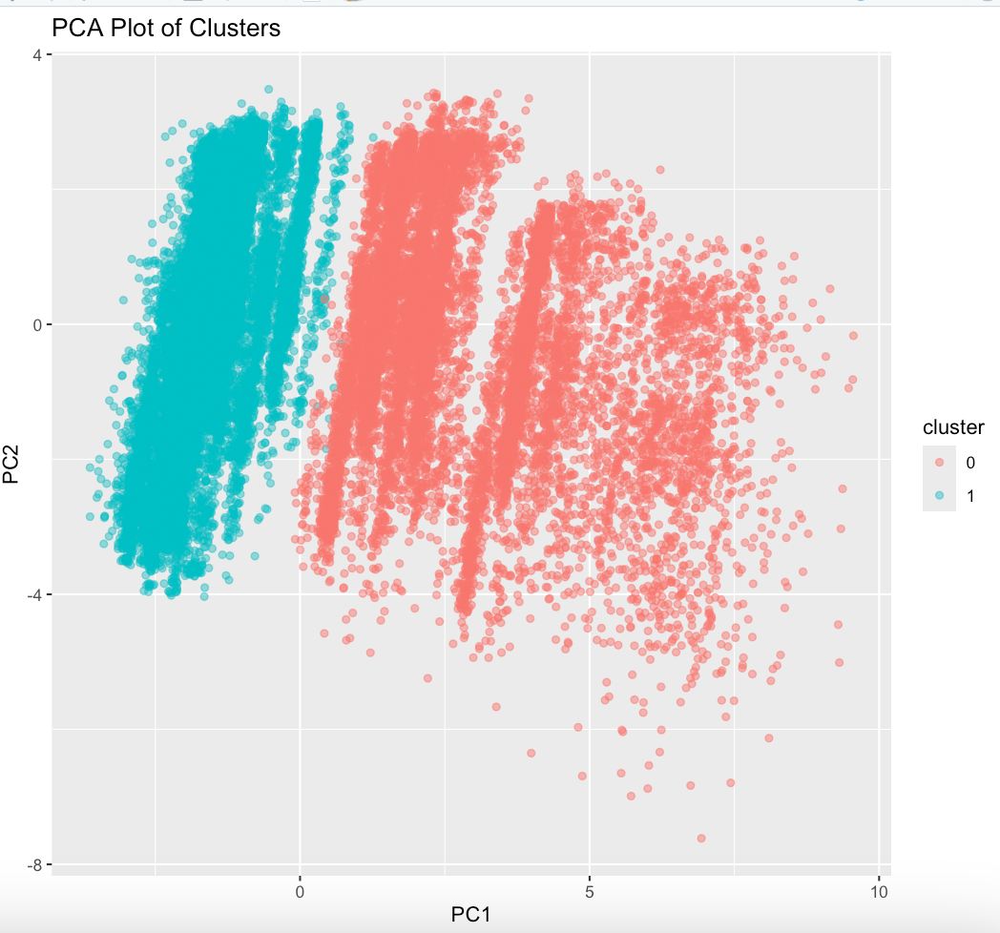


K-means
PCA
Key insights
Cluster Separation
Dimensionality Reduction
Notes:
1. We used K-means clustering to reveal inherent structures in the data.
2. The two clusters (labelled 0 and 1) are well-separated, meaning the selected features effectively distinguish these groups.
3. PCA was used to visualize and retain significant data while reducing dimensionality, facilitating further feature engineering.

Slide 30
Logistic Regression
Notes:
The logistic regression model is ideal for our binary classification and reveals features relationships.

Slide 31



Logistic Regression
Round | Method | Parameter | Accuracy | Sensitivity | Specificity | Balanced Accuracy | AUC (train/test)
Round 1 | Data Normalization | Split Ratio: 0.8 Threshold:0.5 | 0.8976 | 0.9891 | 0.2055 | 0.5973 | 0.7832/0.7805
Round 2 | PCA Feature Engineering | Split Ratio:0.8 Threshold:0.5 | 0.8981 | 0.9890 | 0.2109 | 0.5999 | 0.8137/0.8158
Round 3 | Stepwise Regression Feature Engineering | Split Ratio:0.8 Threshold:0.5 | 0.8976 | 0.9889 | 0.2077 | 0.5983 | 0.7825/0.7826
Round 4 | PCA-based Hyperparameter Tuning | Split Ratio:0.75 Threshold:0.4 | 0.8950 | 0.9765 | 0.2690 | 0.6228 | 0.8130/0.8172
Round 5 | Stepwise Regression-based Hyperparameter Tuning | Split Ratio:0.75 Threshold:0.4 | 0.8968 | 0.9722 | 0.3175 | 0.6448 | 0.7817/0.7850
🌟 Round 6 | Stepwise Regression, Hyperparameter Tuning, And Weighted "YES" Data | Split Ratio:0.75 Threshold:0.4 | 0.7197 | 0.7200 | 0.7171 | 0.7186 | 0.7847/0.7825
Notes:
Now let's explore the performance of our logistic regression models over six rounds.
1. In Round 1 the initial normalization dataset gave 89.76% accuracy, with high sensitivity (98.91%), but low specificity (20.55%). It indicates the model struggled with "YES" customers.
2. In Round 2 and 3: PCA and stepwise regression feature engineering methods just provided little improvement.
3. In Round 4 and 5: Hyperparameter tuning has noticeably improved the identification of "YES" customers.
4. In Round 6: We add weight to “YES” records based on stepwise regression and optimized hyperparameters, which has significantly boosted specificity and balanced accuracy to around 72%.

Slide 32
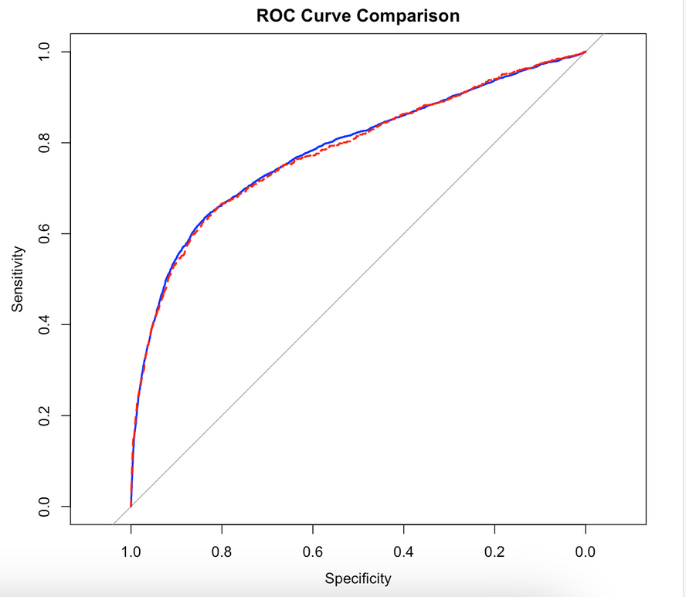
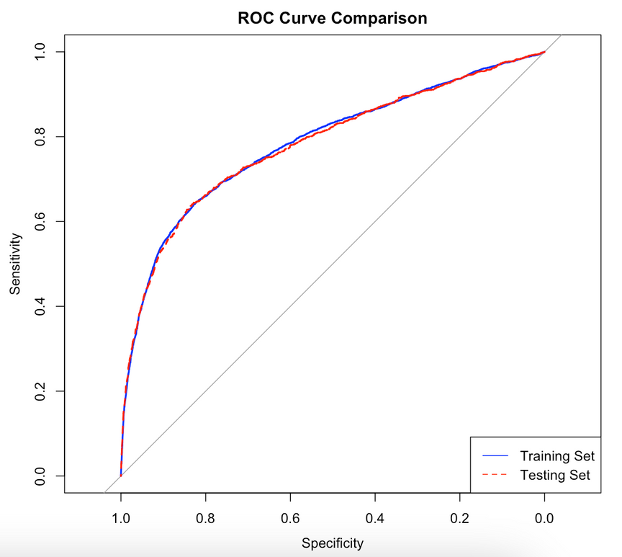
Logistic Regression
Round 1 ROC Curve
Round 6 ROC Curve
Notes:
This is the ROC curve of Round 1 vs Round 6
• In Round 1: The training set ROC curve plateaus at a 0.6 True Positive Rate, indicating limited performance. The testing curve is similar, showing poor generalization.
• However in Round 6: Both training and testing ROC curves improved significantly, demonstrating enhanced generalization, accuracy, and consistency.
now let's move to the SVM model.

Slide 33
Support Vector Machine
Notes:
the second model we chose is SVM, because its ability to find the optimal boundary between possible outputs, especially suitable for binary classification problems.

Slide 34
Method
Parameter
Accuracy
Sensitivity
Specificity
Balanced Accuracy
AUC (train/test)
Round1
normalized data
ratio = 0.7 kernel = "radial" cost=1 gamma=0.01 38 features
0.9095
0.9881
0.1579
0.5730
0.8821/0.7032
Round2
add class weights
ratio = 0.7 kernel = "radial" cost=1 gamma=0.01 38 features
0.8272
0.8468
0.6404
0.7436
0.8420/0.7475
Round3
tune.svm()
ratio = 0.8 kernel = "radial" cost=10 gamma=0.01 38 features
0.8107
0.8278
0.6494
0.7386
0.8435/0.7487
Round4
Feature Engineering
ratio = 0.8 kernel = "radial" cost=1 gamma=0.01 10 features
0.7342
0.7385
0.6930
0.7158
👍 0.7615/0.7624
Notes:
For SVM model, I started with normalized data because SVM is particularly sensitive to the scale of features. Normalization can ensure all features contribute equally to the model.
After the initial training, the model showed high accuracy at 90.95% but a very low specificity of 15.79%. Basically, it was excellent at predicting positive class, but not so good at identifying negative class.
This issue was caused by the imbalanced dataset we mentioned before. So, I introduced class weights during the next round. The class weights are automatically calculated, it increased the penalty for misclassifying the minority class ('yes').
As you can see, this method significantly improved the model’s specificity to 64.04% without reducing overall accuracy. The model now is better balanced and could more effectively identify both classes.
However, the AUC values of the training set and the testing set are not close to each other, means there is a problem of overfitting.
So, I employed the tune.svm() function to find the best parameters, and feature engineering to address the issue.
I eventually selected the top 10 most important features and re-adjusted the parameters of the SVM, the outcomes are shown in round4.
This model achieved the highest specificity and consistent performance on both the training and testing sets, showing a strong generalization capability.

Slide 35
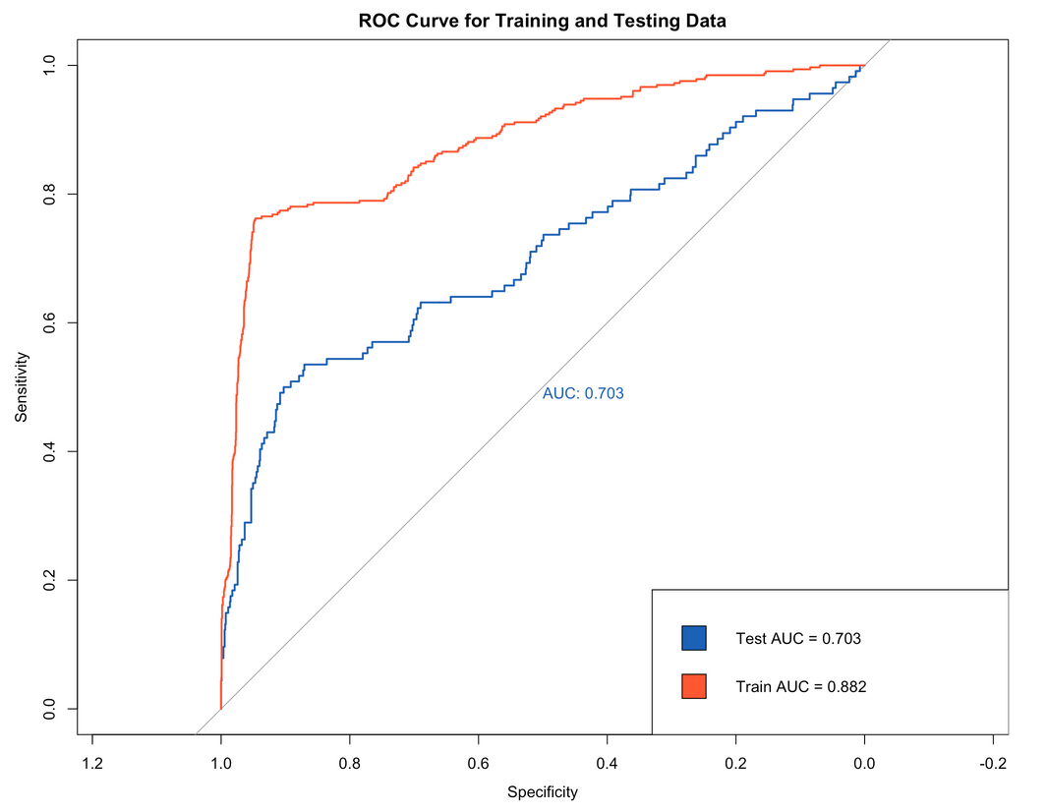
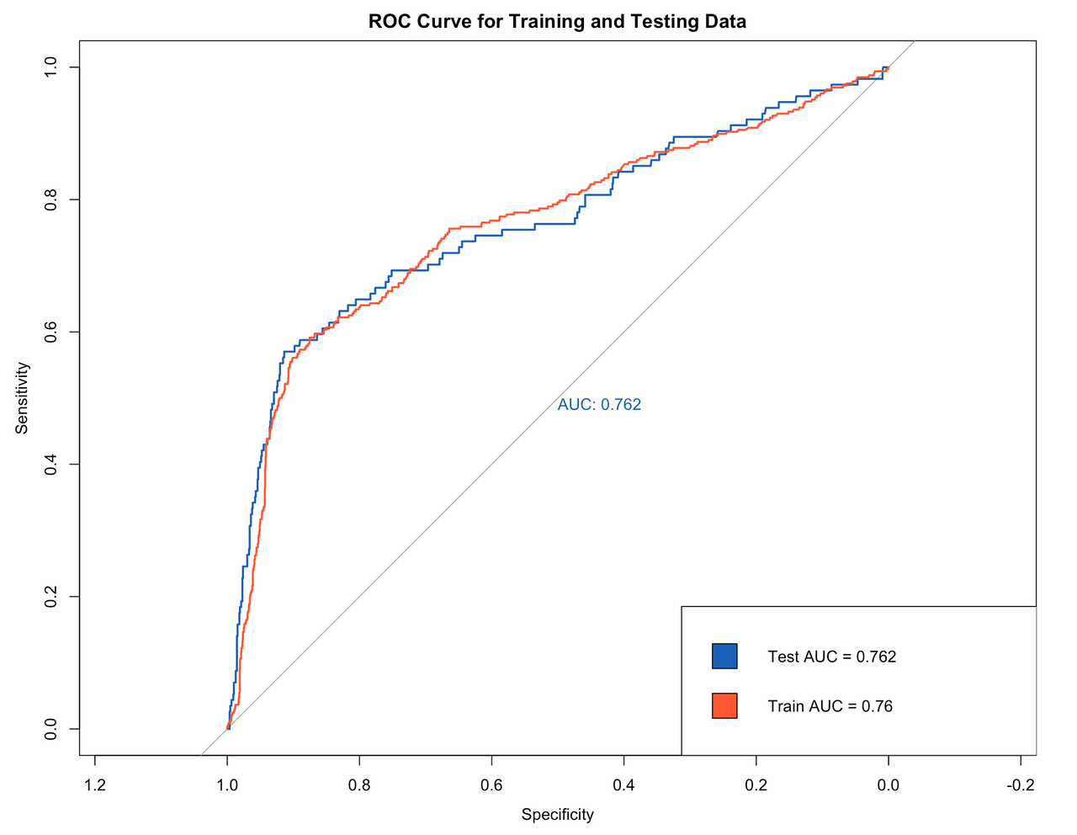
Support Vector Machine
Round1 ROC Curve
Round4 ROC Curve
Notes:
The two pictures are the roc curves. we can see the progress of our model.

Slide 36
Naïve Bayes
Notes:
The next model is Naive Bayes, it is good at classification problems and does not require as many computational resources as SVM.

Slide 37
Method
Parameter
Accuracy
Sensitivity
Specificity
Balanced Accuracy
AUC (train/test)
Round1
cleaned data
ratio=0.7, 38 features laplace=1
0.8036
0.8360
0.5541
0.6951
0.7566/0.7540
Round2
Add class probabilities
ratio=0.7, 38 features laplace=1, apriori = class_probs
0.8358
0.8779
0.5255
0.7017
0.7729/0.7593
Round3
Featuring engineering
ratio=0.7, 18 features laplace=1
0.8447
0.8896
😭 0.4993
0.6945
0.7699/0.7698
Round4
Parameter tuning
ratio 0.9, 38 features laplace = 1
0.8188
0.8524
👍 0.5577
0.7051
👍 0.7704/0.7717
Notes:
Naive Bayes is not sensitive to the scale of features, so I just used the cleaned data.
As you can see, without any data balancing, the model's specificity reached 0.5541, and there was no overfitting observed. This is because Naive Bayes is less sensitive to class imbalance.
But to further optimize the model, I still adjusted its prior probabilities,the results did not improve. This could be when increase the prior probability of “yes” meant the model was more inclined to classify samples as “yes”, this can increase the possibility of mistakenly classifying “no” as “yes”, thus lowering specificity.
Then I tried feature engineering. However, because the most important features in my dataset had strong linear relationships, the model's performance was not satisfactory.
Finally, I gave up the methods and merely adjusted the ratio of the training set to the testing set, and found the optimal ratio was 9:1, which improved the model's specificity and AUC.

Slide 38
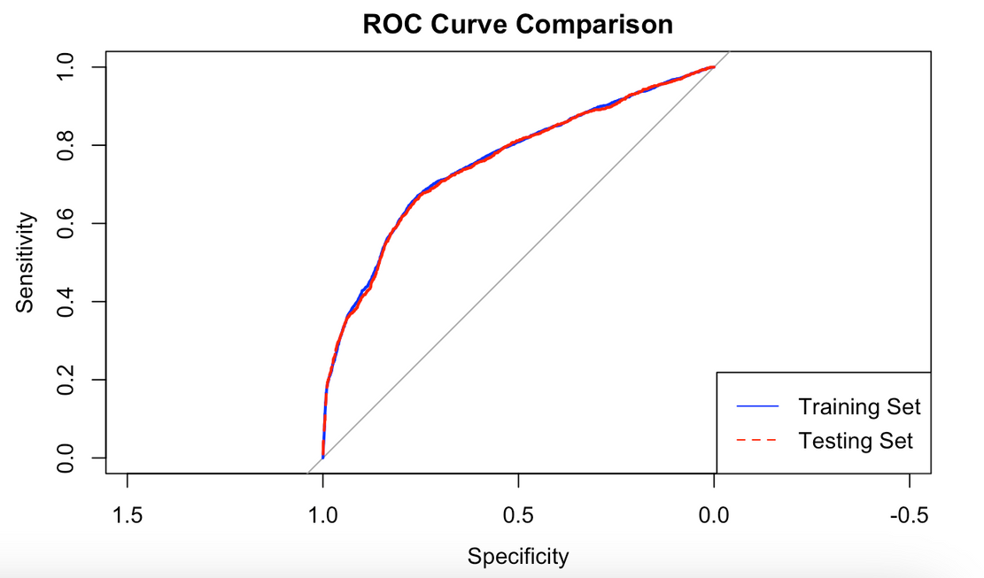
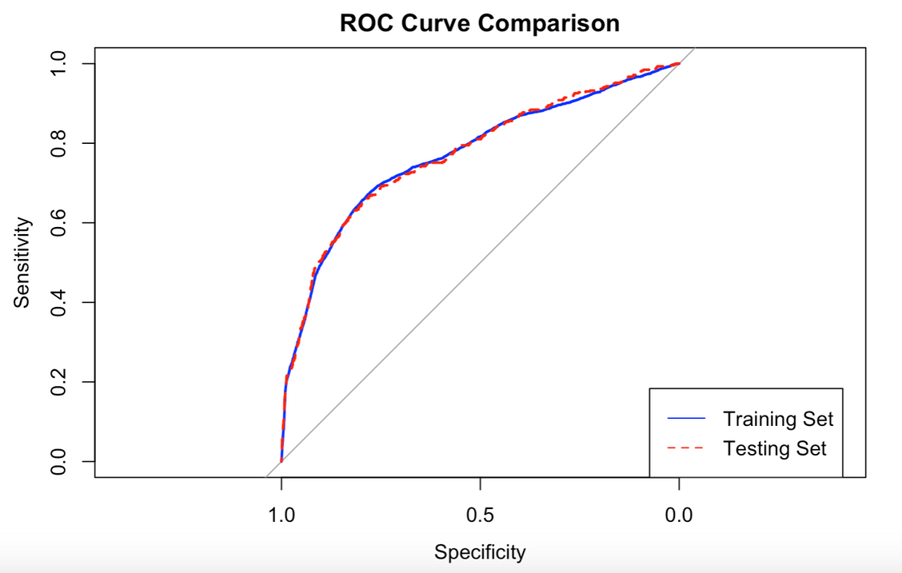
Naïve Bayes
Round1 ROC Curve
Round4 ROC Curve
Notes:
The two pictures are the roc curves of the initial model and the last one. We can’t see many differences, but the area below the curves does improve a bit.

Slide 39
Random Forest

Slide 40
Method
Parameter
Accuracy
Sensitivity
Specificity
Balanced Accuracy
AUC (train/test)
Round1
Default model
Default
0.8985
0.9775
0.2766
0.6271
0.9938/0.7904
Round2
Feature quantity
ntree=200, mtry= 4
0.8987
0.9775
0.2987
0.6281
0.9934/0.7922
Round3
Stratified sampling
ntree=200, mtry= 4, sampsize= c(1000,1000)
0.8521
0.8793
👍0.6379
0.7586
0.9144/0.8046
Round4
Sample data quantity
ntree=200, mtry= 4, sampsize= c(1000,1000), nodesize = 15, maxnodes=850
0.8482
0.8742
0.6437
0.7589
👍0.853/0.8066
Notes:
Round 1
Initially, we used the default settings for training the model and achieved a high overall accuracy of 89.85%. However, the specificity was only 27.66%, indicating poor performance in identifying the "yes" class, which does not meet our target. This suggests that the model is ineffective at handling positive cases and requires further optimization to improve recognition of the "yes" class. The model also showed signs of overfitting based on AUC comparisons.
Round 2
We attempted to improve the model results by setting values for “ntree” and “mtry”. However, the improvements were not significant, and we did not resolve the issues of low specificity and overfitting.
Round 3
In the third round of experiments, we tried to enhance specificity. We explored different “sampsize” values. We conducted stratified sampling during training to ensure an equal amount of "yes" and "no" category data in each decision tree. This approach significantly improved the training results, achieving an accuracy of 85.21% and a specificity of 63.79%, effectively enhancing the model’s ability to recognize the minority class.
Round 4
In the fourth round, we try to solve the overfitting problem. We adjusted the “nodesize” and “maxnode” parameters and thoroughly tested these settings. The accuracy was 84.92% and the specificity was 64.22%, indicating a slight improvement in specificity through adjusting these structural parameters of the trees. These adjustments mainly helped to reduce overfitting on the training set, with AUCs of 85.30% and 80.66% for the training and test sets respectively, thus improving the model's generalization ability.

Slide 41
Method
Parameter
Accuracy
Sensitivity
Specificity
Balanced Accuracy
AUC (train/test)
Round5
Class weight
ntree=200, mtry= 4, sampsize= c(1000,1000), nodesizes=15,maxnodes=850, classwt=c(0.89, 0.11)
0.8403
0.8627
0.6638
0.7632
0.853/0.8064
Round6
Add Threshold
thresholds = 0.56
0.8297
0.8501
👍0.6995
0.7598
👍0.8539/0.8072
Notes:
Round 5
In the fifth round of experiments, we try to continue to improve the model. we tried setting different weights for the "yes" and "no" categories during model training. This adjustment in weights resulted in an accuracy of 84.03% and a specificity of 66.38%. This shows that by setting appropriate category weights, although the improvement was modest, it effectively enhanced the model's ability to recognize the minority class and somewhat mitigated the effects of data imbalance.
Round 6
In the sixth round of experiments, we attempted to further improve the model. We adjusted the model's decision threshold and tested different thresholds. Through this method, we found an appropriate threshold that provided the highest specificity. Following this adjustment, the model's accuracy was 82.97% and the specificity reached 69.95%. This indicates that optimizing the decision threshold, despite a decrease in accuracy, significantly improved specificity and effectively enhanced the model’s ability to recognize the "yes" class, helping to better address the classification issues in an imbalanced dataset.

Slide 42
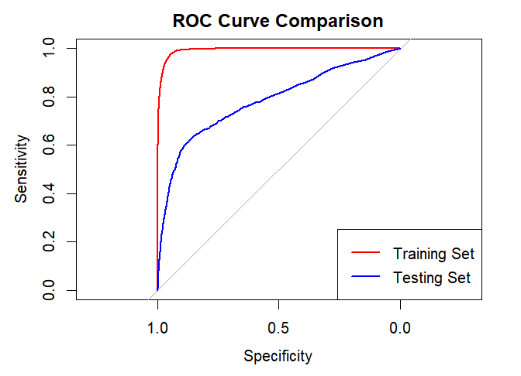
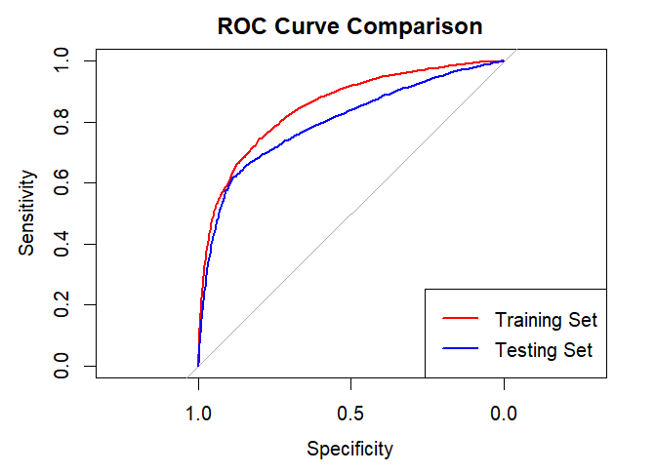
Random Forest
Round1 ROC Curve
Round6 ROC Curve
Notes:
In conclusion, compared to the initial model, our training results showed significant improvements:
• We effectively resolved the overfitting problem seen in the first round of experiments.
• There was a notable increase in the predictive accuracy for the "yes" class.

Slide 43
Group 20
Content
Introduction Problem Definition Objective Challenge Dataset Description
Methods Data Pre-Processing Performance Measures Model Training and Optimizing
Results Model Comparison Performance Measures Model Training and Optimizing
Discussion Knowledge Discovery Objective Challenge Dataset Description

Slide 44
Model Comparison
Model | Accuracy | Sensitivity | Specificity | Balanced Accuracy | AUC (train/test)
Logistic Regression | 0.7197 | 0.7200 | 0.7171👍 | 0.7186 | 0.7847/0.7825
SVM | 0.7342 | 0.7385 | 0.6930 | 0.7158 | 0.7615/0.7624
Naive Bayes | 0.8188 | 0.8524 👍 | 0.5577 | 0.7051 | 0.7704/0.7711
Random Forest🌟 | 0.8297 👍 | 0.8501 | 0.6995 | 0.7598👍 | 0.8539/0.8072👍
Notes:
Naive Bayes has the best specificity (0.5577),
Logistic Regression performs best in sensitivity (0.7200), demonstrating its keen ability to identify non-purchasers.
SVM was the most balenced option.
Random Forest again has the highest Accuracy,balanced accuracy ,AUC.
If bank focus is on prediction accuracy and model generalizability, Random Forest remains the best choice. The Logistic Regression model shows the best performance in identifying non-purchasers, which might be suitable in scenarios where it’s crucial to not miss any potential non-purchasers. The choice of each model should still be based on specific business needs and performance metrics.

Slide 45
Model Comparison
Logistic Regression | SVM | Naïve Bayes | Random Forest
+ Easily readable insights Computationally efficient Probabilistic framework Less likely to overfit - Difficult to obtain complex relationships Highly sensitive to outliers | + Works well with high-dimensional data Robust against overfitting _ High computational and memory requirements Difficulty in probability estimation | + Simple and easy to implement Offers fast training and prediction speeds - Feature independence assumption is often unrealistic Poor performance when feature correlation is high | + Diverse feature types High precision Automatic feature selection - High model complexity High memory usage
Notes:
Logistic Regression:
Advantages: Provides easily interpretable insights, computationally efficient, based on a probabilistic framework, less prone to overfitting.
Disadvantages: Struggles to capture complex relationships, highly sensitive to outliers.
Support Vector Machine (SVM):
Advantages: Well-suited for high-dimensional data, robust against overfitting.
Disadvantages: High computational and memory requirements, difficulty in probability estimation.
Naive Bayes:
Advantages: Simple and easy to implement, offers fast training and prediction speeds.
Disadvantages: Assumes independence between features, which is often unrealistic, performs poorly when feature correlation is high.
Random Forest:
Advantages: Can handle diverse types of features, high precision, automatic feature selection.
Disadvantages: High model complexity, large memory usage.

Slide 46
Group 20
Content
Introduction Problem Definition Objective Challenge Dataset Description
Methods Data Pre-Processing Performance Measures Model Training and Optimizing
Results Model Comparison Performance Measures Model Training and Optimizing
Discussion Knowledge Discovery Objective Challenge Dataset Description

Slide 47
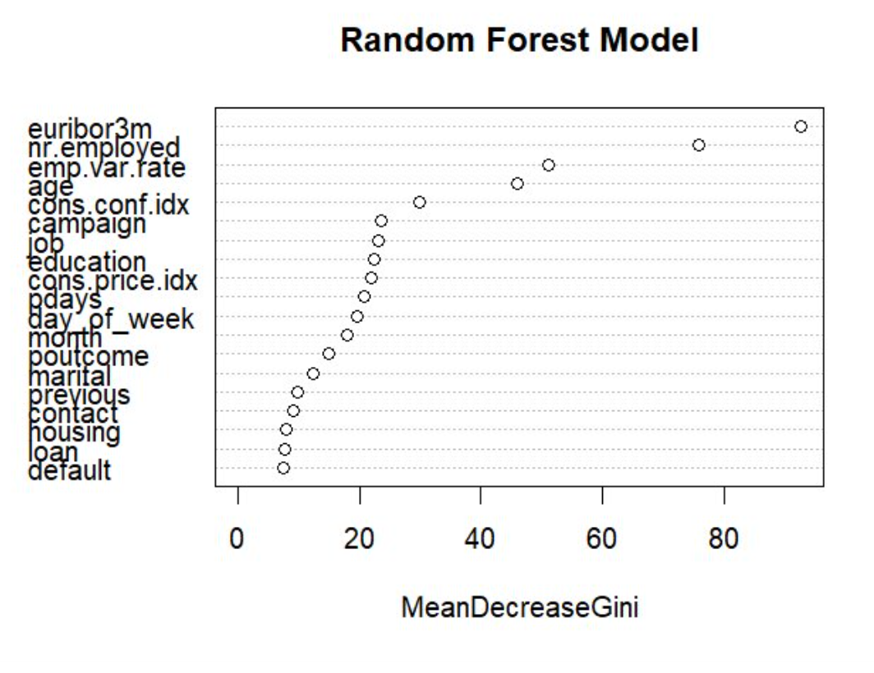
Knowledge Discovery
Random Forest
Increase Term Deposit
Subscriptions Insights
MeanDecreaseGini
Indicates the importance of each feature in the model.
The higher the Gini reduction, the greater the impact of that feature in the model on the predicted outcomes.
Top 5 Important Features:
euribor3m
nr.employed
emp.var.rate
age
cons.conf.id
Notes:
We got this Mean Decrease Gini values from Random Forest.
This metric indicates the importance of each feature within the model: the higher the Gini decrease value, the more significant the feature's impact on the predictive outcomes.
euribor3m (euribor 3 month rate/3-month Euro Interbank Offered Rate)and nr.employed(number of employees),emp.var.rate (employment variation rate), age and consumer confidence index are the top 5.

Slide 48
Knowledge Discovery
Logistic Regression
Increase Term Deposit
Subscriptions Insights
Variable | Estimate Std. | Error | Z value | Pr(>|z|) | OddsRatios
Education | 0.045523 | 0.011917 | 3.820 | 0.000133 *** | 1.0465754
Contact | 0.474545 | 0.015523 | 30.570 | < 2e-16 *** | 1.6072824
Emp.var.rate | -1.375403 | 0.060344 | -22.793 | < 2e-16 *** | 0.2527378
Cons.price.idx | 0.670062 | 0.029348 | 22.832 | < 2e-16 *** | 1.9543590
Euribor3m | 0.462764 | 0.083750 | 5.526 | 3.29e-08 *** | 1.5884583
Nr.employed | -0.189086 | 0.054770 | -3.452 | 0.000556 *** | 0.8277152
Jobretired | 0.104362 | 0.024139 | 4.323 | 1.54e-05 *** | 1.1100017
Previously_contacted | 0.231616 | 0.028845 | 8.030 | 9.77e-16 *** | 1.2606361
Day_of_week | 0.017012 | 0.009570 | 1.778 | 0.075459 | 1.0171573
Housing | -0.008838 | 0.009572 | -0.923 | 0.355808 | 0.9912006
Client associated factors：
High education level
Retired people
Bank associated factors:
Contact via "cellular" instead of "telephone
Contact before campaign
Environmental associated factors
(the 2008 financial crisis):
Low emp.Var.Rate
High cons.Price.Idx
High euribor3m
Low nr.Employed
Notes:
We can see the relative impact of different feature variables on the decision of whether a person subscribes to a deposit product.
if people with High education level and they are Retired have more posibility to purchase the deposit product
Bank associated factors:
Contact via "cellular" instead of "telephone,Contact before campaign
Economic Environmental is also important :
Low Emp.var.rate ,High Cons.price.idx ,High Euribor3m ,Low Nr.employed
during the 2008 financial crisis,people will prefer to deposit
Banks can use this information to more accurately target potential customers, designing products and marketing strategies that better meet their needs.

Slide 49
THANK YOU!

Slide 50
Q&A Time

